Slide 1
Travel Assured Case Study
Manuel Urbano Rodriguez
Travel Insurance Market Insights
04 March 2022

Slide 2
Introduction
Business Problem
Methodology
Due to the COVID pandemic, Travel Assured cut the marketing budget by over 50%.
A new market strategy needs to be defined for an efficient use of the reduced budget.
Travel habits of current customers and non-customers need to be analysed.
We are interested in knowing whether customers travel more often and travel more abroad than non-customers.
We have access to the data of 1987 customers and non-customers with ages in the range of 25 to 35 with a variety of backgrounds and personal circumstances.
The analysis will cover how the different characteristics of the customers relate to each other to be able to target the marketing strategy to the right sector.
The language used for the analysis is Python with the libraries Pandas, Seaborn and Matplotlib.

Slide 3
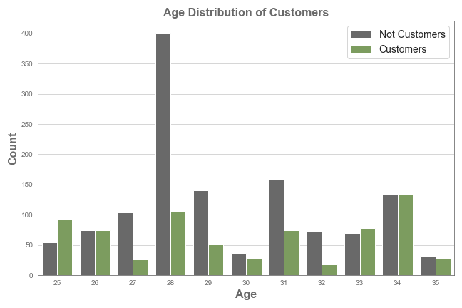
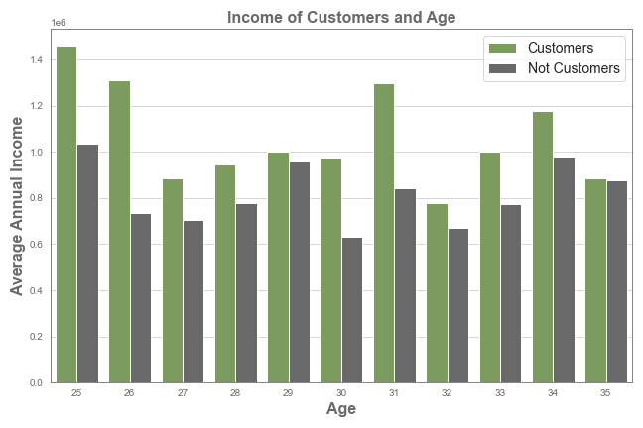
Analysis
What is the distribution of the Customers age and their income?
From the distribution of Ages of Customers and Not Customers, no clear conclusion can be withdrawn.
The majority of Customers have higher income than Not Costumers, being the difference smaller as the age of the customer increases.
Mean Customers Annual Income: 1,065,309.90
Mean Not Customers Annual Income: 816,824.49

Slide 4
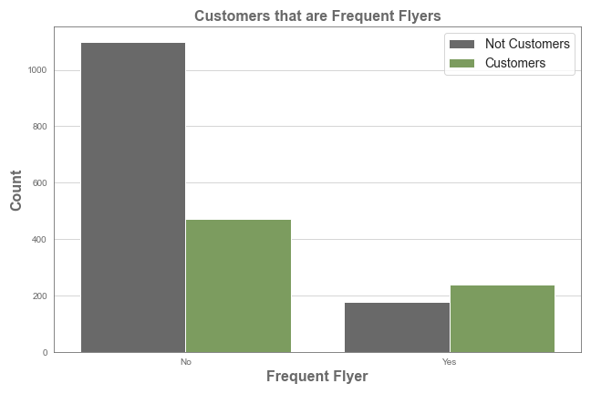
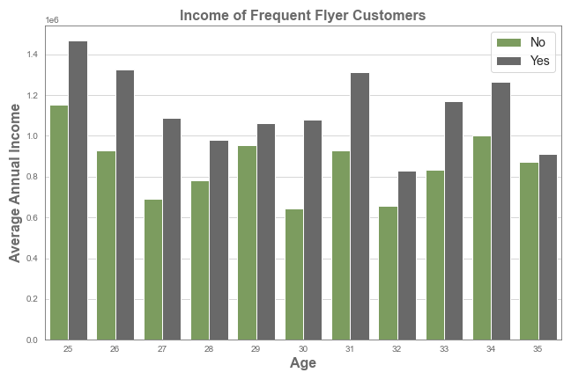
Analysis
How does the Frequency of flying affect Customers/Not Customers?
The number of Not Frequent Flyers that are Not Customers is more than twice as large as the Customers. However, the majority of Frequent Flyers are Customers.
In general, travellers with a greater Annual Income tend to travel More Frequently than those with a lower income.
Mean Customers Annual Income: 1,135,841.08
Mean Not Customers Annual Income: 859,232.23

Slide 5
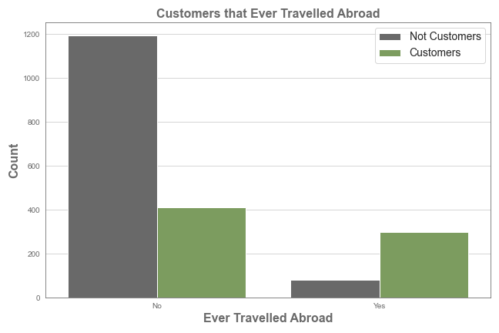
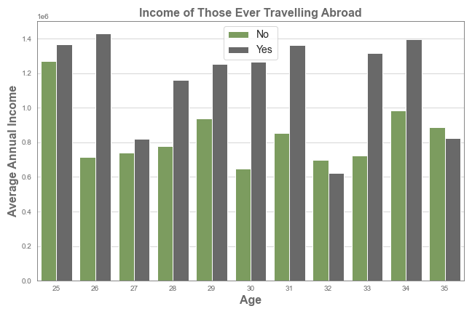
Analysis
How does it impact the fact that Customers have Never Travelled Abroad?
One-fourth of the travellers that have never been abroad are Customers. However, only one-fifth of the travellers that have been abroad are Not Customers.
The Income of travellers who have been abroad tends to be higher except for two age groups (32 and 35).
Mean Customers Annual Income: 1,165,423.07
Mean Not Customers Annual Income: 838,936.61

Slide 6
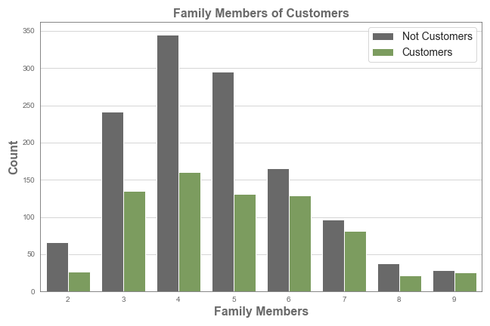
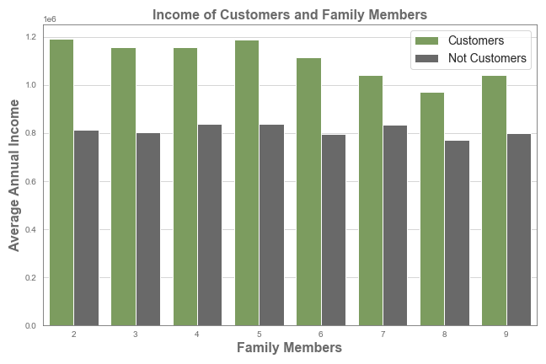
Analysis
What this the relationship between Family Members and Customers?
Families with an amount of members greater or equal to 6 are more often Customers than smaller families. This could be due to large family discounts.
Different family sizes have a similar income regardless of them being Customers or Not. However, the income difference between them is 36.51%.
Mean Customers Annual Income: 1,107,966.75
Mean Not Customers Annual Income: 811,633.59

Slide 7
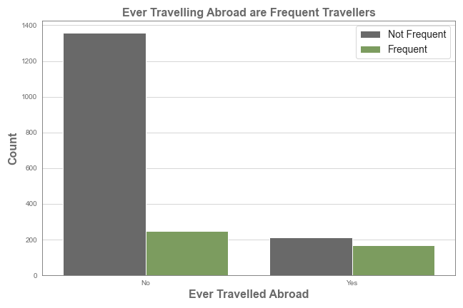
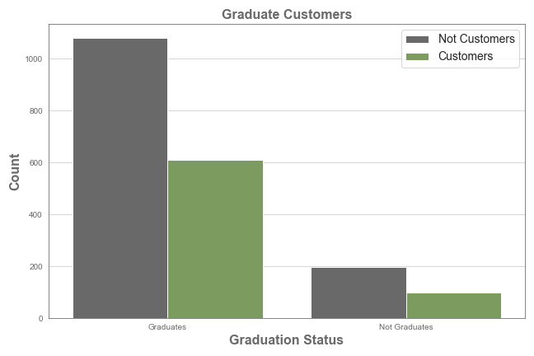
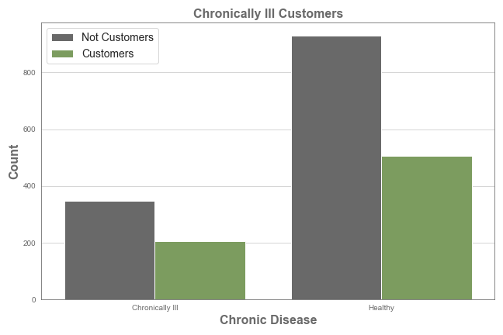
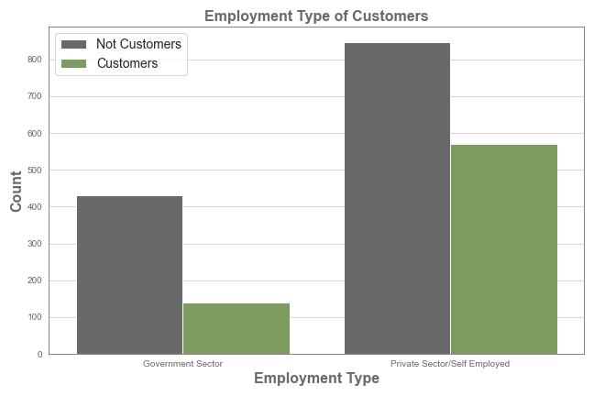
Analysis
Additional Analysis
Travellers that have been abroad tend to be more frequent travellers.
The fact that travellers are Graduates or Not does not affect whether they choose to buy our travel insurance.
Chronically Ill Travellers tend to buy more often our travel insurance than Healthy Costumers.
Travellers from the Government Sector tend to buy less often our travel insurance than those of the Private Sector.

Slide 8
Conclusions
Good Engagement Rate
International Travellers Need Being Insured
The Percentage of travellers that are Customers is 35.73%.
Only one-fifth of the travellers that have been abroad are Not our Customers.
The Annual Income of Customers is Key
Larger Families get Insured More Often
Our Customers have an Annual Income 30.42% higher than Non-Costumers.
Smaller Families (less than 6 members) should be targeted to incentivise them to be insured. Discount plans could be revised.
Frequent Travellers are Keen on Being Insured
Travellers with a greater Annual Income tend to travel More Frequently than those with a lower income. The majority of Frequent Flyers are Customers.

